Slide 1
InspectionXpert Single-Button Inspection Plan
Jeff Cope
CONFIDENTIAL

Slide 2
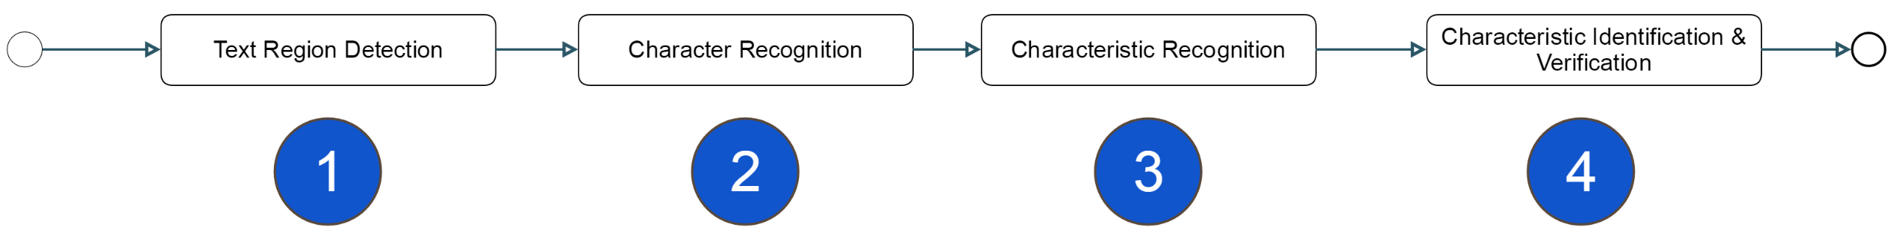
Automated Characteristic Identification and Extraction

Slide 3
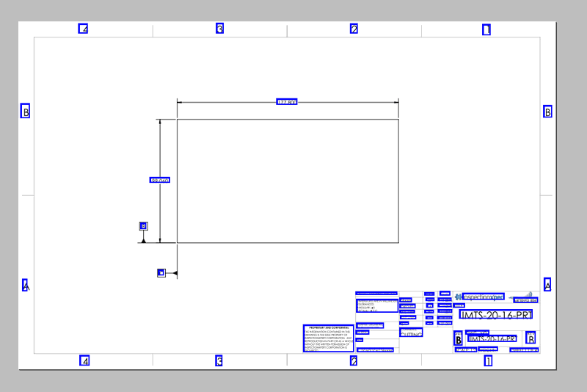
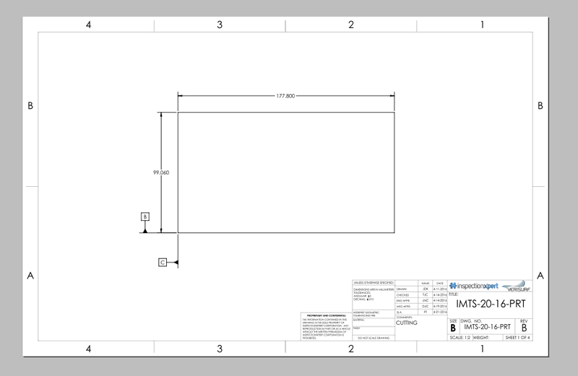
(Possible) Text Region Detection
Load Drawing
Locate All Text

Slide 4
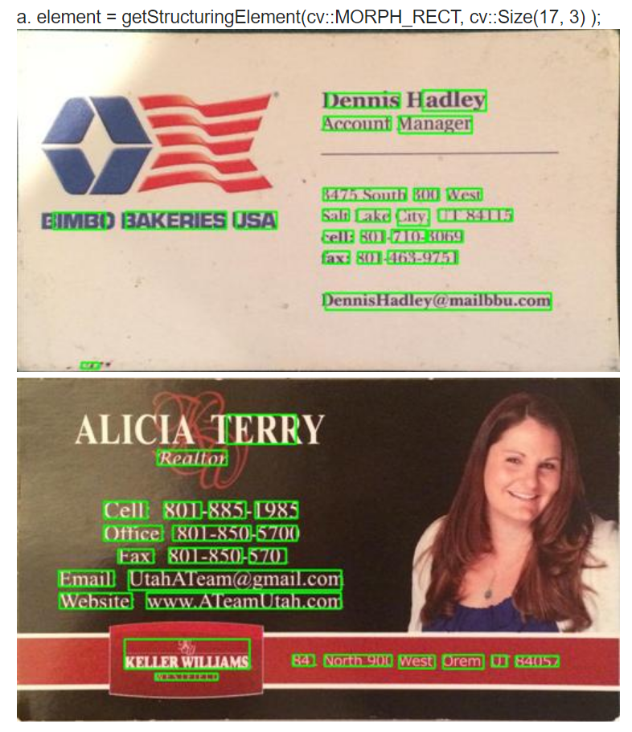
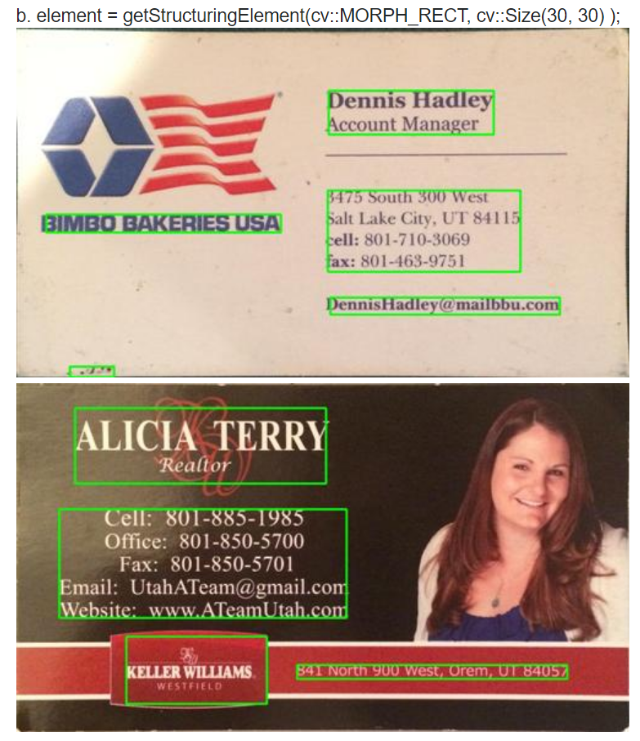
Grouping Text Regions
https://stackoverflow.com/questions/23506105/extracting-text-opencv
https://docs.opencv.org/3.0-beta/modules/text/doc/erfilter.html

Slide 5

Character Recognition
Obtain the individual characters contained within the text region.
⌀1.000 +.005
-.002

Slide 6
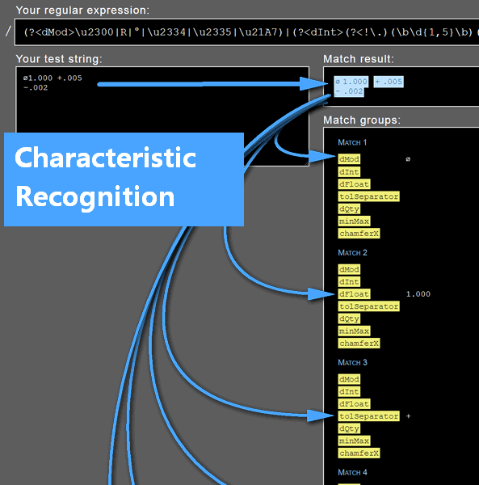
Characteristic Recognition
Parse the characters in the text and
1) determine if it is a characteristic
2) If it is, then set the appropriate characteristic properties (e.g. type, sub-type, nominal, etc…)

Slide 7
Suggested Regex
Regex:
(?<dMod>\u2300|R|°|\u2334|\u2335|\u21A7)|(?<dInt>(?<!\.)(\b\d{1,5}\b)(?!\.))|(?<dFloat>(\d{0,5}\.\d{1,5}))|(?<tolSeparator>[±+-])|(?<dQty>(?:\d{1,3}[xX]|\(\d{1,3}\s?[Pp][Ll]([Aa][Cc][Ee][Ss])?\)))|(?<minMax>[Mm][Aa][Xx]|[Mm][Ii][Nn])|(?<chamferX>\s[Xx]\s)
Note:
This Regex will identify the relevant components of a dimension and return them accordingly. Logic must be written to set the tolerance and dimension type based upon which items are returned by the regex.

Slide 8
Characteristic Identification & Verification
Out of scope for phase I

Slide 9
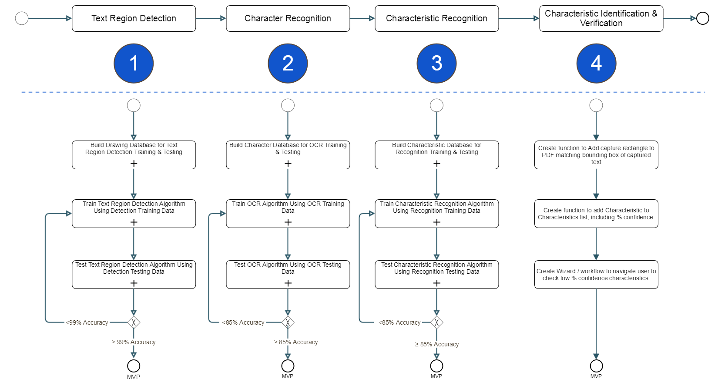
Training & Testing the Algorithms

Slide 10
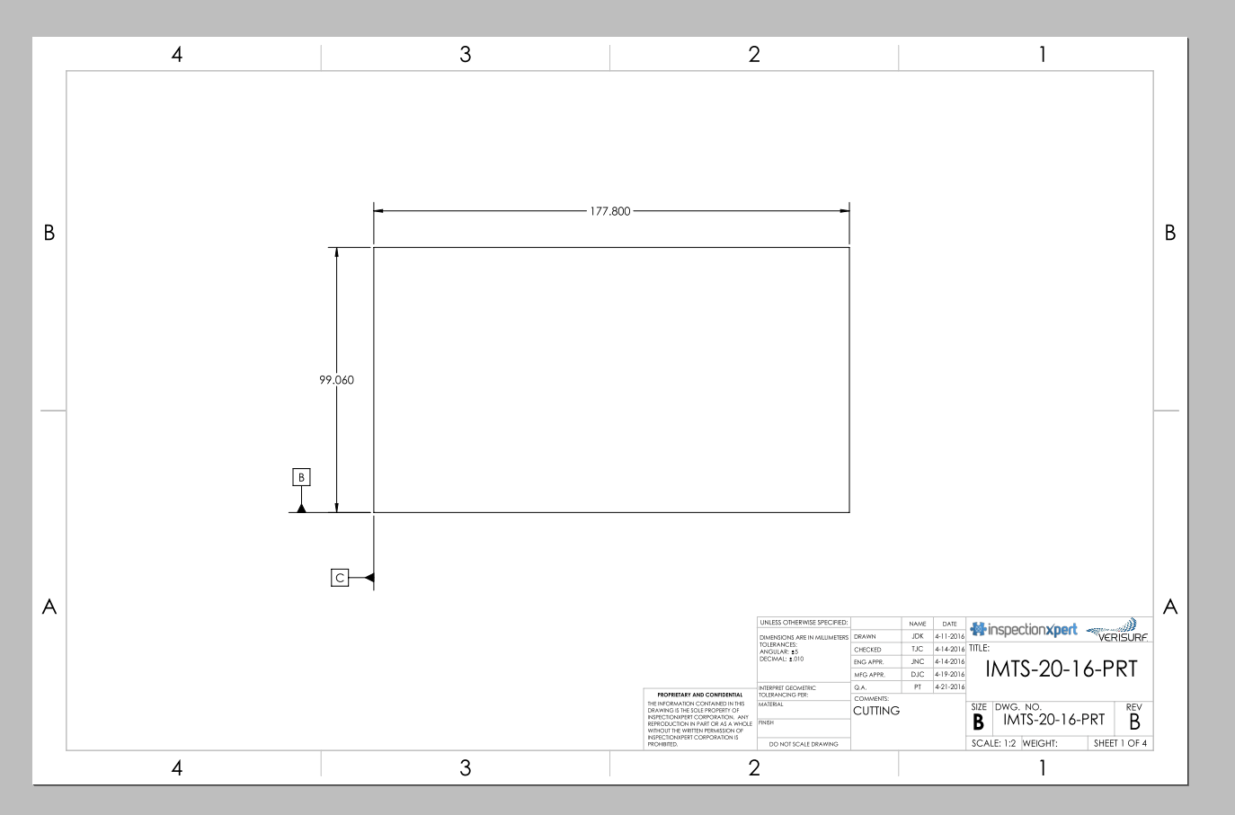
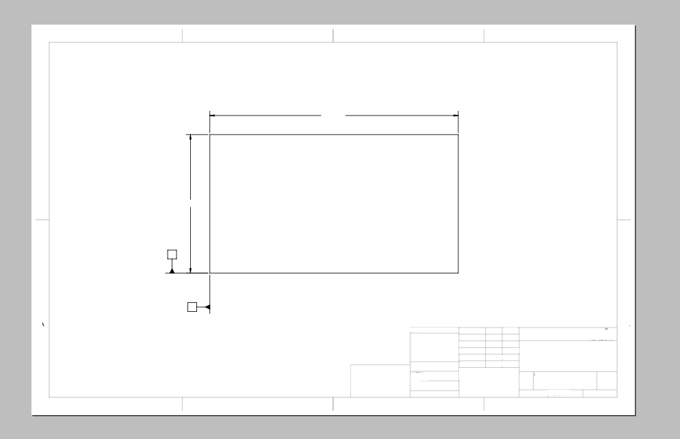

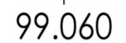













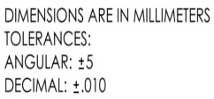


























3 Data Requirements for Text Region Detection Training
1
2
3
Drawings with text regions
Drawings without text regions
Images of text regions

Slide 11

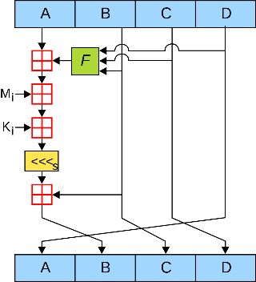
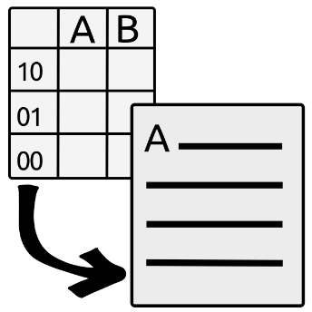
5 Requirements for Text Region Detection Testing
1
An algorithm to test
2
3
4
5
Drawings with text regions
Drawings without text regions
Correct answers (image & location)
Record of run & % error calculation

Slide 12
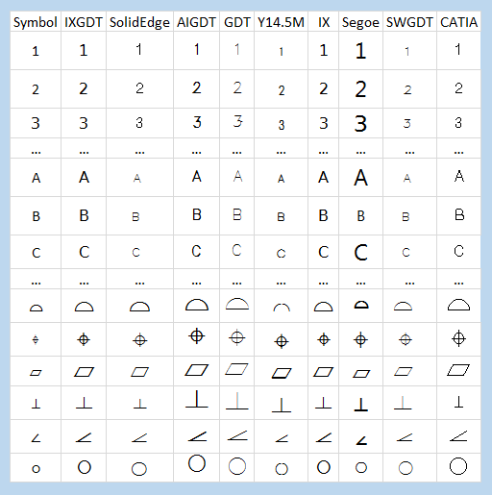
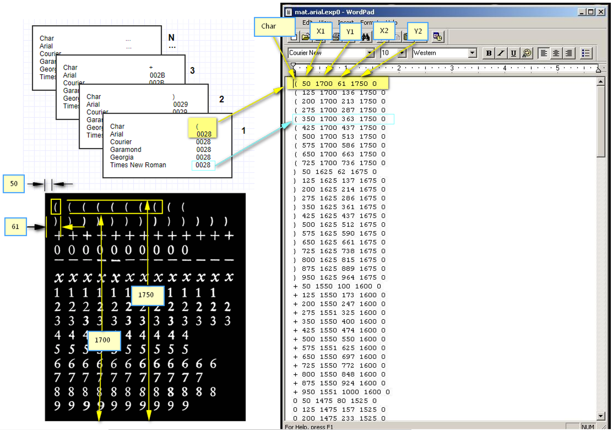
Requirements for Character Recognition Training
Note: Phase I will use Tesseract OCR
Representative sample of drawing fonts…
Image file and corresponding box file for each character, rendered with each of the selected fonts.

Slide 13
































Training for Characteristic Recognition

